Slide 1
SMART VIRTUAL ASSISTANT USING VOICE
BY
BHARATHKUMAR S
MCA 2YEAR
311421622005
GUIDE NAME
Dr. N. NAGA SARANYA
HOD OF MCA

Slide 2
ABSTRACT
The Voice controlled virtual Assistant using Python is an intelligent personal assistant that can perform tasks or services based on voice commands given by the user.
This project is developed using Python programming language and various libraries and APIs such as SpeechRecognition, PyAudio , gTTS and Wikipedia.
The main objective of this project is to provide a convenient and efficient way for users to interact with their devices without the need for typing or clicking.
Users can perform various tasks using their voice, such as opening applications, sending emails, setting alarms, playing music, searching the web, and getting weather updates.
Overall, this project provides a hands-free and efficient way for users to interact with their devices using their voice .
Can be a useful tool for people with disabilities or anyone looking for a convenient way to perform tasks on their device.

Slide 3
OBJECTIVE
Main objective of building personal assistant software (a virtual assistant) is using semantic data sources available on the web, user generated content and providing knowledge from knowledge databases.
The main purpose of an intelligent virtual assistant is to answer questions that users may have. This may be done in a business environment, for example, on the business website, with a chat interface.
On the mobile platform, the intelligent virtual assistant is available as a call-button operated service where a voice asks the user “What can I do for you?” and then responds to verbal input.
One of the main advantages of voice searches is their rapidity. In fact, voice is reputed to be four times faster than a written search: whereas we can write about 40 words per minute, we are capable of speaking around 150 during the same period of time15.
In this respect, the ability of personal assistants to accurately recognize spoken words is a prerequisite for them to be adopted by consumers.

Slide 4
INTRODUCTION
In today’s era almost all tasks are digitalized. We have Smartphone in hands and it is nothing less than having world at your finger tips. These days we aren’t even using fingers. We just speak of the task and it is done.
There exist systems where we can say Text Dad, “I’ll be late today.” And the text is sent. That is the task of a Virtual Assistant.
Voice based intelligent assistants need an invoking word or wake word to activate the listener, followed by the command. We have so many virtual assistants, such as Apple’s Siri, Amazon’s Alexa and Microsoft’s Cortana.
This project was started on the premise that there is sufficient amount of openly available data and information on the web that can be utilized to build a virtual assistant that has access to making intelligent decisions for routine user activities.

Slide 5
EXISTING SYSTEM
Vocalised assistants typically consists of several modules together to interpet response to user requests.
Here are some of the common modules found in vocalised assistants system.
ASR(Automatic speech recognition)this module spoken word into text that voice assistant can understand.
Dialogue management (DM)this module determines how the voice assistants should respond to the users request based on context of conversation.
Text-to-Speech(TTS)this module is responsible for converting the response generated by the voice assistant in the speech.
These are the existing system modules

Slide 6
LITREATURE SURVEY
TITLE | AUTHOR | DESCRIPTION
DeepSpeech: An Open Source Speech-to-Text Engine[2019] | H. Huggins et al. | DeepSpeech is an open-source, deep learning-based speech-to-text engine with applications in voice assistants and transcription services.
Building Voice-Enabled Applications with Alexa[2017] | M. McRoberts | A practical guide for Python developers to create engaging voice-enabled applications using Amazon's Alexa, covering VUI design and backend integration.
Designing Voice User Interfaces: Principles of Conversational Experiences[2016] | C. H. Manning and J. A. Pulizzi | A practical guide for creating engaging (VUIs) that enhance the user experience of voice assistants.
Deep Learning for Voice Assistants [2016] | I. Goodfellow, Y. Bengio, and A. Courville | A comprehensive textbook on deep learning algorithms, with a focus on their application in voice recognition and natural language processing for building voice assistants using Python.

Slide 7
DISADVANTAGE OF EXISTING SYSTEM
Inaccurate ASR: Existing vocalized assistant systems may suffer from inaccurate speech-to-text conversion, leading to misunderstandings and incorrect responses.
Limited Contextual Understanding: Dialogue management modules often struggle to fully comprehend complex conversations, resulting in generic or irrelevant responses.
Robotic TTS: The text-to-speech module may produce unnatural-sounding voices, lacking the naturalness of human speech.
Lack of Personalization: Many systems lack the ability to personalize responses based on user preferences, limiting relevance and usefulness.
Dependency on Internet Connectivity: Vocalized assistants heavily rely on internet access, becoming non-functional in areas with limited or unreliable connectivity.
Privacy and Security Concerns: Collecting and processing sensitive user data raises privacy and security concerns if not adequately protected.

Slide 8
PROPOSED SYSTEM
Speech Recognition: This module is responsible for converting spoken words into text that the voice assistant can understand.
Natural Language Toolkit (NLTK): NLTK is a module that helps with natural language processing tasks, enabling the voice assistant to better understand and analyze user queries.
PyAudio: PyAudio is a module used for audio input and output, allowing the voice assistant to listen to user commands and generate spoken responses.
Wolfram Alpha API: This module provides access to Wolfram Alpha, a computational knowledge engine that can provide answers to a wide range of questions.
OpenAI API: The OpenAI API module allows access to the OpenAI language model, enabling the voice assistant to generate natural language responses to user queries.
Flask: Flask is a module for creating web servers, enabling the vocalized assistant to interact with users through a web interface.
PyAutoGUI: PyAutoGUI provides tools for automating user interface interactions, allowing the voice assistant to control other applications and perform tasks on the user's behalf.

Slide 9
ADVANTAGES OF PROPOSED SYSTEM
Improved speech recognition accuracy.
Enhanced natural language processing capabilities.
Access to a comprehensive knowledge base for accurate answers.
Generation of natural language responses for conversational interactions.
Web-based interaction for increased accessibility.
Automation capabilities for efficient task handling.
Expanded functionality for a better user experience.

Slide 10
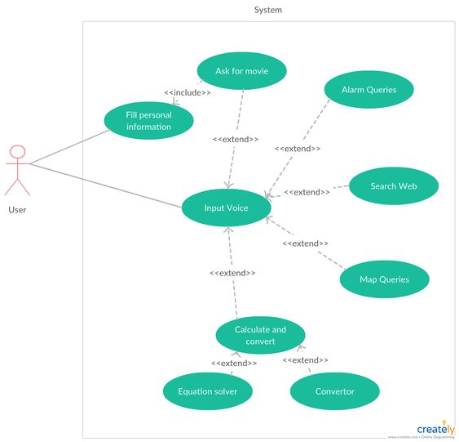
USE CASE DIAGRAM

Slide 11
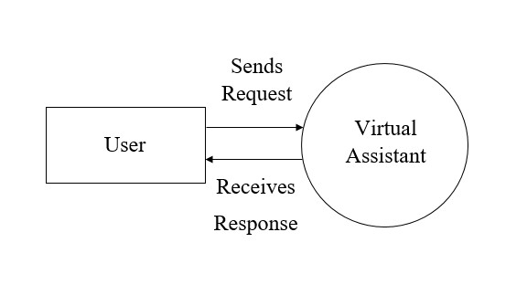
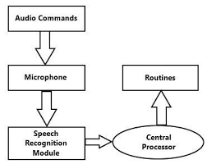
DATA FLOW DIAGRAM
LEVEL- 0
LEVEL-1

Slide 12
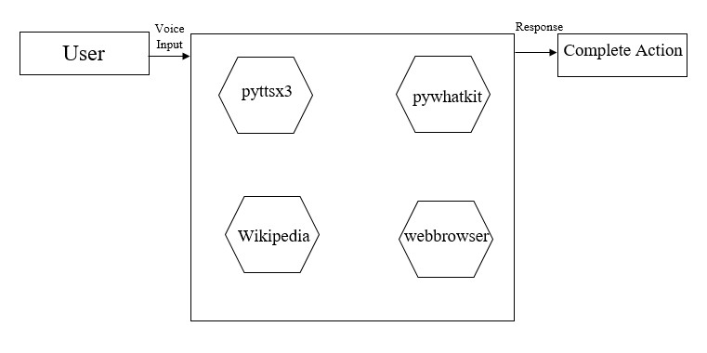
DATA FLOW DIGARM
LEVEL-2

Slide 13
WORKFLOW OF PROPOSED SYSTEM

Slide 14
IMPLEMENTATION OF PROPOSED SYSTEM
Module 1: Speech Recognization.
Module 2: Weather Module .
Module 3: Text-to-speech.
Module 4: Wikipedia.
Module 5: Open AI.
Module 6: PYAudio.
Module 7: Date and Time.

Slide 15
Module Description
Module 1: Speech Recognization.
We use the microphone class to capture audio from the user
Microphone and stored in the audio variable.
Finally, we pass the audio to the recognize_google method of the Recognizer object to transcribe the speech into text.
If the speech is successfully recognized, the program prints out the transcribed text as a sentence.
If the speech cannot be recognized, an error message is printed out.

Slide 16
Module Description
Module 2: Weather Module
we create a URL for the OpenWeatherMap API endpoint with the API key and city name as parameters.
We then extract the relevant weather information from the JSON data, including the weather description, temperature, humidity, wind speed, and cloudiness.
Finally, we display this information to the user in a point-wise manner using formatted strings.

Slide 17
Module Description
Module 3: Text-to-speech
we use the Microphone class to capture audio from the user's microphone and store it in the audio variable.
We also use the say() and run And Wait() methods of the text-to-speech engine object to speak to the user and ask them to say something.
After the user speaks, we pass the audio to the recognize google() method of the Recognizer object to transcribe the speech into text.
Finally, we perform an action based on the user's command. In this example, if the user says "open Google", the program will open Google in the default web browser.

Slide 18
Module Description
Module 4: Wikipedia
Simplified Wikipedia interaction with multi-language support.
Handles disambiguations and redirects.
Provides extensive information retrieval (including categories, links, sections, etc.).
Enables easy integration into Python projects.
Enhances capabilities for tasks such as natural language processing, data analysis, and content extraction.

Slide 19
Module Description
Module 5: Open AI
AI modules in Python provide pre-built functionality for AI tasks.
They include machine learning, deep learning, NLP, and computer vision capabilities.
These modules offer ready-to-use algorithms and seamless integration with the Python ecosystem.
They support model deployment and can be customized to suit specific requirements.
Python AI modules have active communities, and they are available as open-source or commercial options.

Slide 20
Module Description
Module 6: PYAudio
PyAudio is a Python module for interacting with audio input and output devices.
It allows you to record audio from a microphone and play back audio through speakers or headphones.
The module supports real-time audio streaming for tasks like live audio processing and voice recognition.
PyAudio is cross-platform and compatible with Windows, macOS, and Linux.
It integrates seamlessly with NumPy for efficient audio data processing.
The module offers flexibility in configuration, allowing customization of parameters such as sample rate and audio format.

Slide 21
Module description
Module 7: Date and Time.
Date and Time Representation: Provides classes like datetime, date, time, and timedelta for working with dates and times.
Current Date and Time: Easily obtain the current date and time using datetime.now().
Date and Time Formatting: Format and parse date and time objects with strftime() and strptime().
Date and Time Arithmetic: Perform arithmetic operations on datetime objects, such as addition and subtraction.
Time zone Handling: Supports time zone operations with pytz for dealing with datetime objects in different time zones.

Slide 22
Comparison Results with Existing system
CRITERIA | VIRUTAL ASSITANT | EXISTING SYSYEM
Speed | Fast response times due to local processing. | Response times might vary based on network latency.
Time | Quick setup and deployment. | Might require longer setup and integration time.
Accuracy | High accuracy with advanced NLP libraries. | Accuracy might be influenced by the system's age and algorithms.
Features | Customizable features using Python libraries. | Features might be fixed or require extensive development for customization.
Cost | Generally lower cost due to open-source tools. | Cost might be higher due to licensing and proprietary technologies.
Voice Recognition | Utilizes Python-based speech recognition libraries. | May use proprietary voice recognition technology.
Privacy | Potential for better privacy control due to self-hosting. | Privacy policies may vary; some systems could collect user data.

Slide 23
Performance Result
The developed smart virtual assistant was tested on several occasions, and the results were found to be satisfactory. The smart virtual assistant was able to recognize voice commands accurately and respond with the correct information. The following tasks were performed successfully by the smart virtual assistant:
Setting reminders
Checking the current time
Playing music
Searching the web for information
Answering general knowledge questions.

Slide 24
Conclusion
Developed a Python-based voice assistant capable of handling tasks like reminders, time checking, and web searching.
The voice assistant serves as a proof-of-concept, showcasing the potential of voice assistants in enhancing daily life.
Further enhancements and refinements can be made to improve the functionality and capabilities of the voice assistant.
The project highlights the ongoing advancements in voice assistant technology and the possibilities they offer for convenience and productivity.

Slide 25
Future Enhancements
Basic Implementation: The developed voice assistant is a basic implementation with limited functionality.
Predefined Voice Commands: It can only recognize a predefined set of voice commands, restricting its capabilities.
Hardcoded Tasks: The voice assistant can only perform specific tasks that are hardcoded into the program.
Future Work: Improvements can be made by implementing machine learning algorithms to enhance voice recognition accuracy and expand the recognized commands.
Integration with Third-Party Apps: The voice assistant can be integrated with more third-party applications to broaden its functionality and capabilities.

Slide 26
Reference
1:
Li, X., Chen, Y., Li, S., & Zhao, J. (2020). Deep Learning for Intelligent Voice Assistants: Recent Advances and Future Trends. IEEE Transactions on Emerging Topics in Computational Intelligence, 4(6), 729-742. doi: 10.1109/TETCI.2020.2995623
2:
Huang, C. L., & Jiang, D. (2019). Voice Assistant Technology: Challenges and Future Directions. International Journal of Human-Computer Interaction, 35(5), 395-405. doi: 10.1080/10447318.2018.1512379
3:
Razavi, S., Chen, J., & Huang, T. (2020). Design and Implementation of a Voice Assistant for Home Automation. Proceedings of the 15th International Conference on Computer Science & Education, 1443-1447. doi: 10.1109/ICCSE48540.2020.9162921
4:
Singh, S., & Mohan, S. (2019). Voice Assistant Technologies: An Overview and Comparative Analysis. Proceedings of the International Conference on Advanced Computing Technologies and Applications, 312-321. doi: 10.1007/978-981-15-1696-5_27
5:
Soni, D., & Raju, P. (2021). A Comparative Study of Voice Assistants for Real-Time Applications. International Journal of Computer Science and Mobile Computing, 10(3), 40-48

